Slide 1
Pro-ana vs pro-recovery
Gabriela suchopárová, 20. 1. 2020

Slide 2
Pro-ana vs pro-recovery dataset
Available on Kaggle
Context
“In my Abnormal Psychology class, I learned about how pro-anorexia/pro-eating disorder material online can be harmful, so I decided to make a dataset, in hopes that it would help someone with the necessary skills to make a model that might end up helping someone some day.”
No models or notebooks available yet

Slide 3
Dataset
Binary classification – pro-recovery (0) vs pro-ana (1) data
Roughly 2x more pro-ana data (1234 vs 2135 samples)
Text data
Already splitted into sentences
Sources are probably articles, blog posts and reddit posts
Train and test set
Test set size – 0.1

Slide 4
Model
To train a network, it is necessary to convert words into a numeric representation
Embedding – words are mapped to vectors of real numbers
word2vec – a model that produces an embedding
I used a library – word2vec-keras
Allows to train both the word2vec embedding and a neural network
The neural network contains one LSTM layer and three dense layers by default

Slide 5
Model hyperparameters
 | Hyperparameter | Default value
word2vec | w2v_size | 300
 | w2v_epochs | 100
NN | k_max_sequence_len | 500
 | k_batch_size | 128
 | k_epochs | 32
 | k_lstm_neurons | 128
 | k_hidden_layer_neurons | [128, 64, 32])

Slide 6
First model
No preprocessing, no change in hyperparameters
Results not good – test accuracy around 0.5
Changing the hyperparameters does not help
The data needs some preproccesing

Slide 7
Data preprocessing #1
Tokenize based on whitespaces
Remove punctuation and other symbols (keep only letters)
A lot of sentences started with ‘tcb-script]’ – removed
Remove stop words (commonly used words like ‘a’, ‘is’)
Library NLTK (Natural Language Toolkit)
Stemming (plays, playing → play)
May help in case of small datasets

Slide 8
Second model – with preprocessing
Best results for w2v_size = 50, k_lstm_neurons = 10; k_epochs = 120
The default values are too large for this dataset
Also reducing k_max_sequence_len – slightly better results, but training was much quicker
Accuracy: 0.601
Can we do better?

Slide 9

Data preprocessing #2
Some of the examples contain mingled words
‘…self-destructive behaviorbiological causes of anorexia include:irregular hormone functionsgenetics although scientist…’
wordninja project
A small user-written program
Separates mingled words, results are quite nice
It may produce some meaningless words like ‘li’ if it does not know a particular word though

Slide 10
Third model – with wordninja
Same hyperparameters as before
Accuracy: 0.664
The result is better, but still not good enough

Slide 11
Data preprocessing #3
As the texts are extracted from blog posts or reddit, it may contain some ‘noise’
‘ⓒ 2019 about, inc’
‘all rights reserved’
Badly splitted bullet lists (one very long sentence)
A list of all american states (probably from a form)
Some of these were manually removed
About 200 examples

Slide 12
Final model
With the ‘cleaned’ dataset
Accuracy: 0.71
Reducing k_batch_size = 32, removed stemming
Accuracy: 0.729
The model accuracy does not improve with k_epochs larger than 150
Training accuracy is not larger than 0.87, so there are still some limits
Some of them may be due to ‘mislabeled’ data

Slide 13
Pretrained word2vec
Google trained a word2vec model on a very large dataset
GoogleNews-vectors-negative300
Freely available on their webpages
vector('king') - vector('man') + vector('woman') is close to vector('queen’)
Used instead of the trained embedding in previous models
The model was not trained anymore – just the NN
Only a subset was used – the words that appear in our dataset
Reduced training time and model size
Source code of the word2vec-keras had to be modified

Slide 14
Model with pretrained word2vec
Default settings of NN hyperparameters (except k_max_sequence_len)
Accuracy: 0.813
Batch size 32
Accuracy: 0.82
k_lstm_neurons = 20
30 epochs – Accuracy 0.844
50 epochs – Accuracy 0.863
70 epochs – Accuracy 0.875
Larger number of epochs (or other changes) does not improve the result

Slide 15
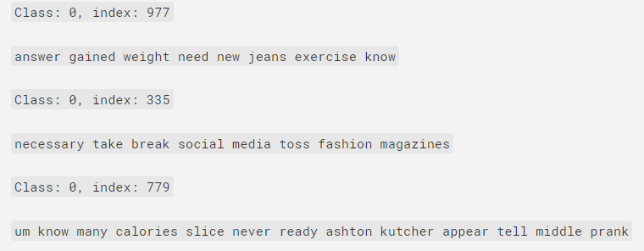
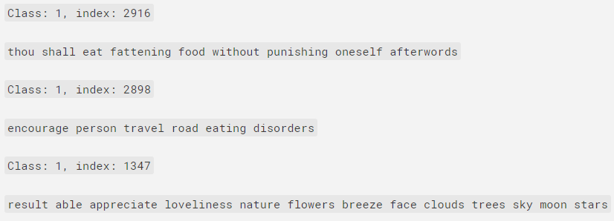
Mislabeled data

Slide 16
Summary
Preprocessing is necessary in this dataset
Stemming does not produce better results
The pretrained model is much better than manually trained word2vec
Probably due to a small number of different training patterns
Model | Test accuracy
No adjustments | ~0.5
With preprocessing | 0.66
Best model | 0.729
Best model (google) | 0.875

Slide 17
Possible improvements
Try out some more preprocessing (examine data)
Consult changes with dataset author
Collect more data
Collect more ‘normal’ data
Model changes
Number of dense layers, hidden neurons
CNN instead of LSTM
…
Working model could be turned into a browser extension

Slide 18
Thank you for your attention

